Slide 1
”DIKSHA” Sundaram Fin.Tech 2025
Anil Rasa
Date : 30-Apr-2025

Slide 2

Docker Presentation….!

Slide 3
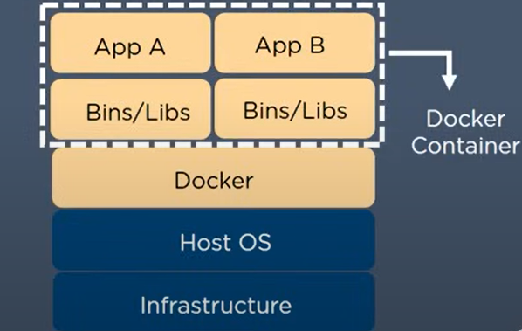
What is Docker ?
→Docker Image
→Docker Container
→Docker Registry
→Docker Compose
→Docker Hub
→Docker Networks
Why Docker?
Hb
Q

Slide 4
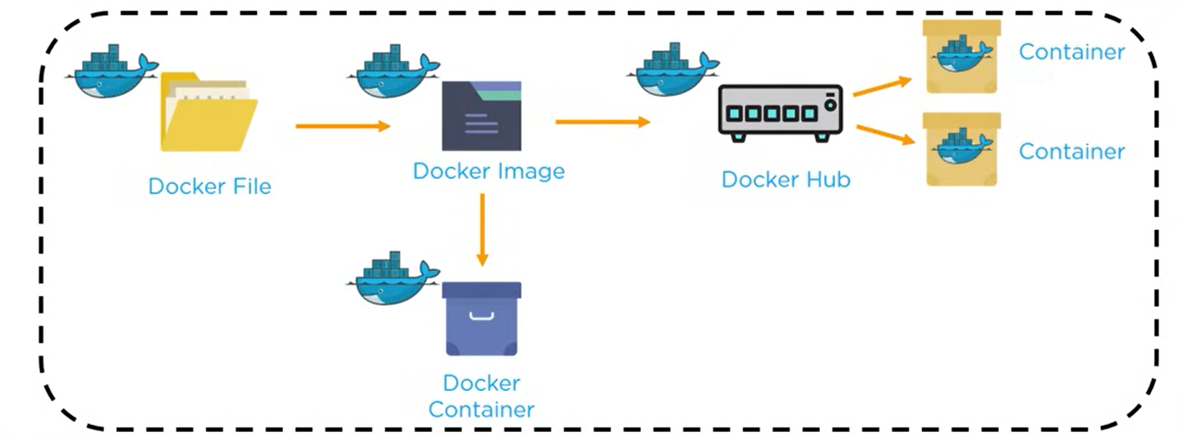

Slide 5
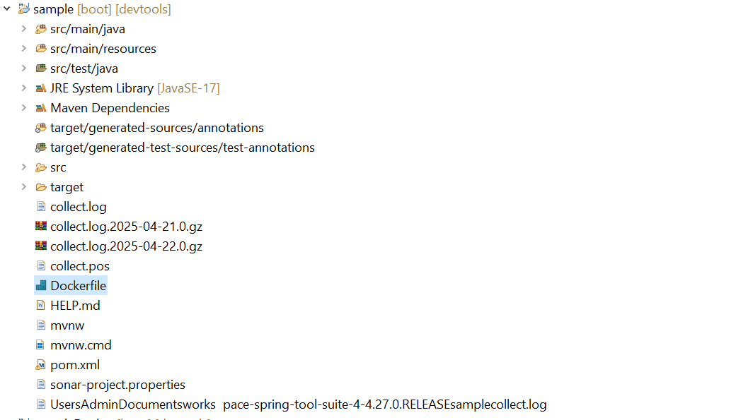
Simple Spring Boot Application:

Slide 6
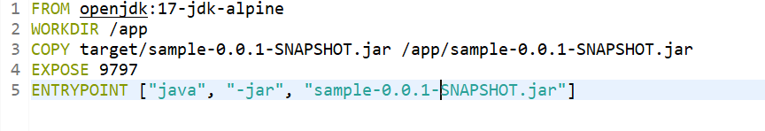
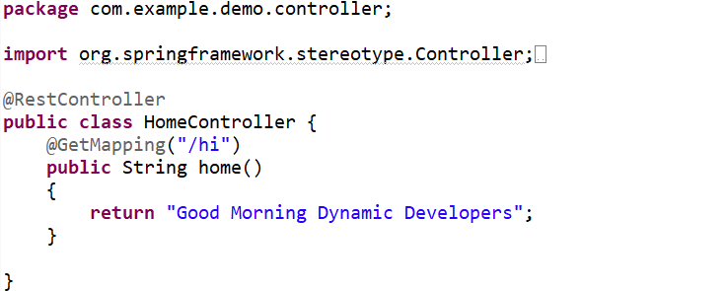
Docker File:
Controller:

Slide 7
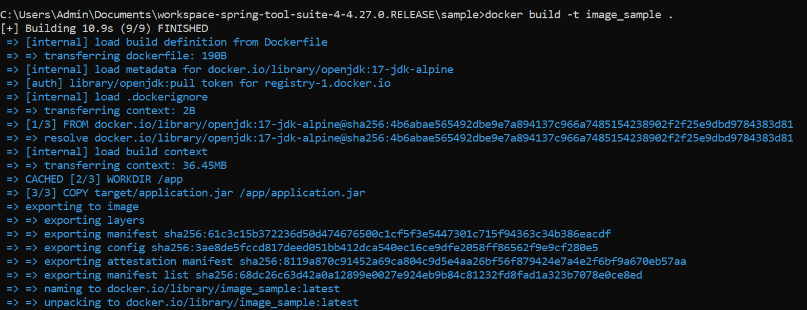
Docker Image:

Slide 8
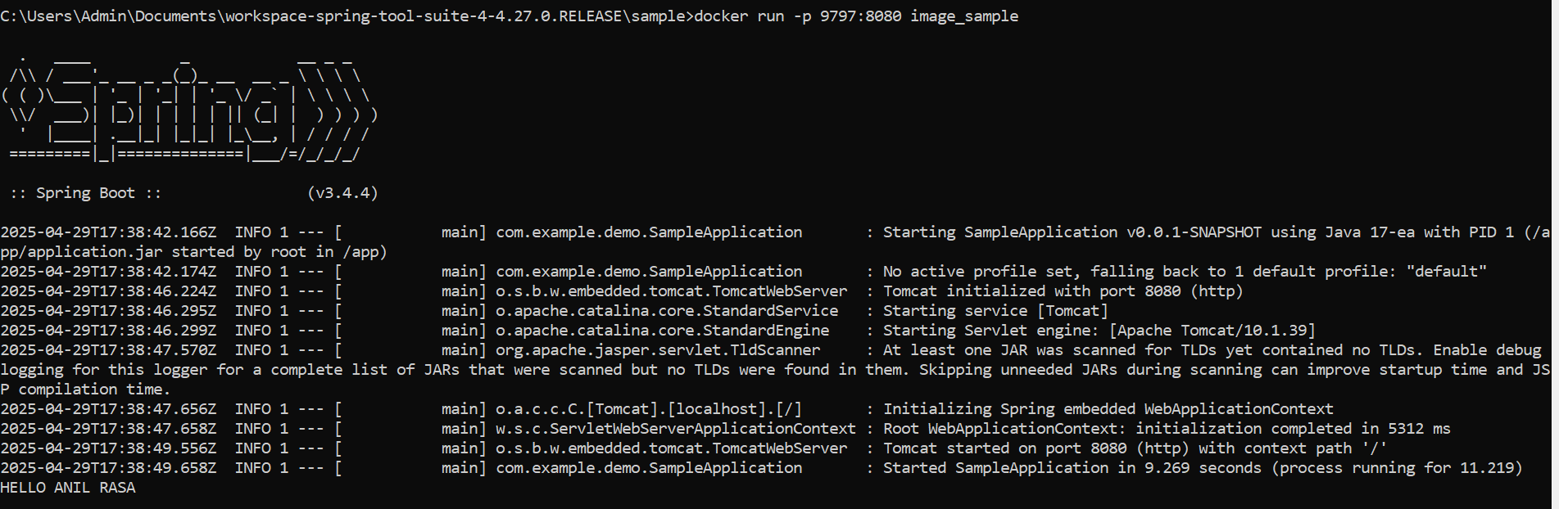
Docker Container:

Slide 9
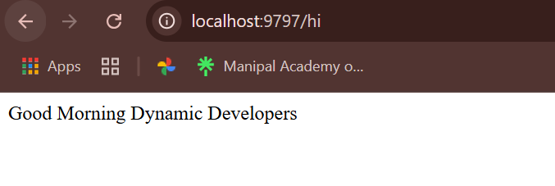
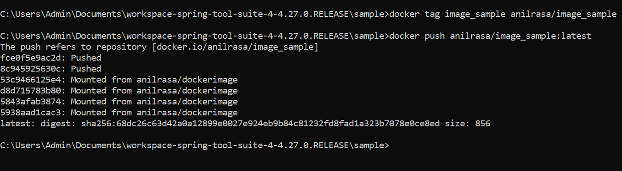
Output:
Push Image to dockerhub:

Slide 10
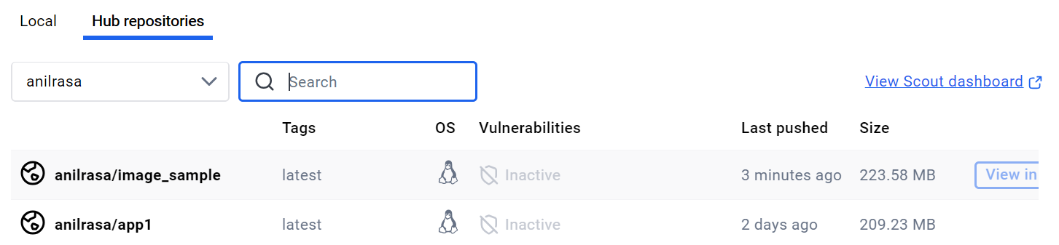
Hub Repository:

Slide 11
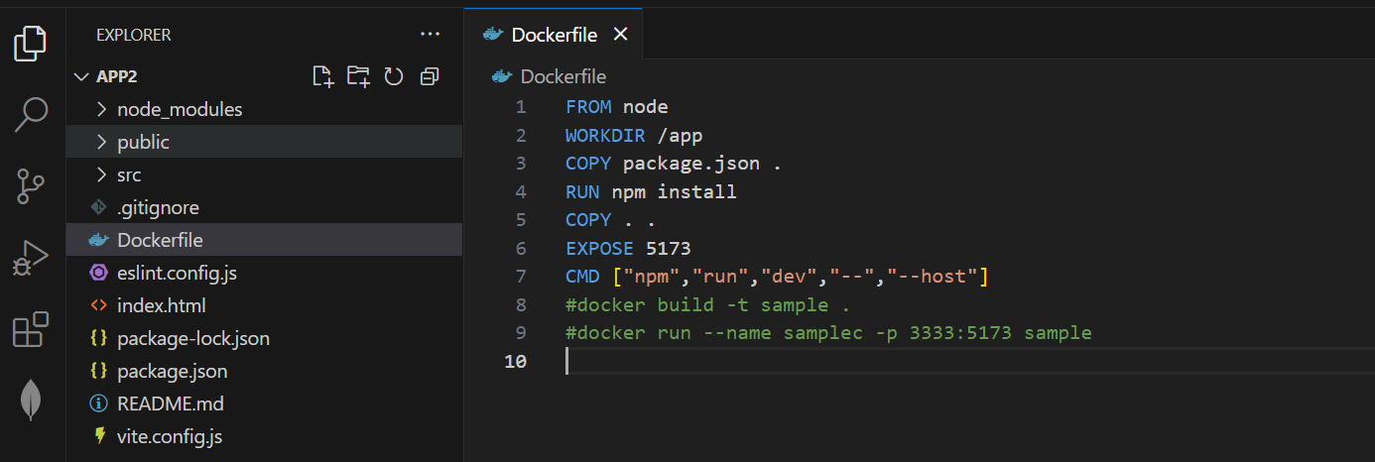
React_app (Vite):

Slide 12
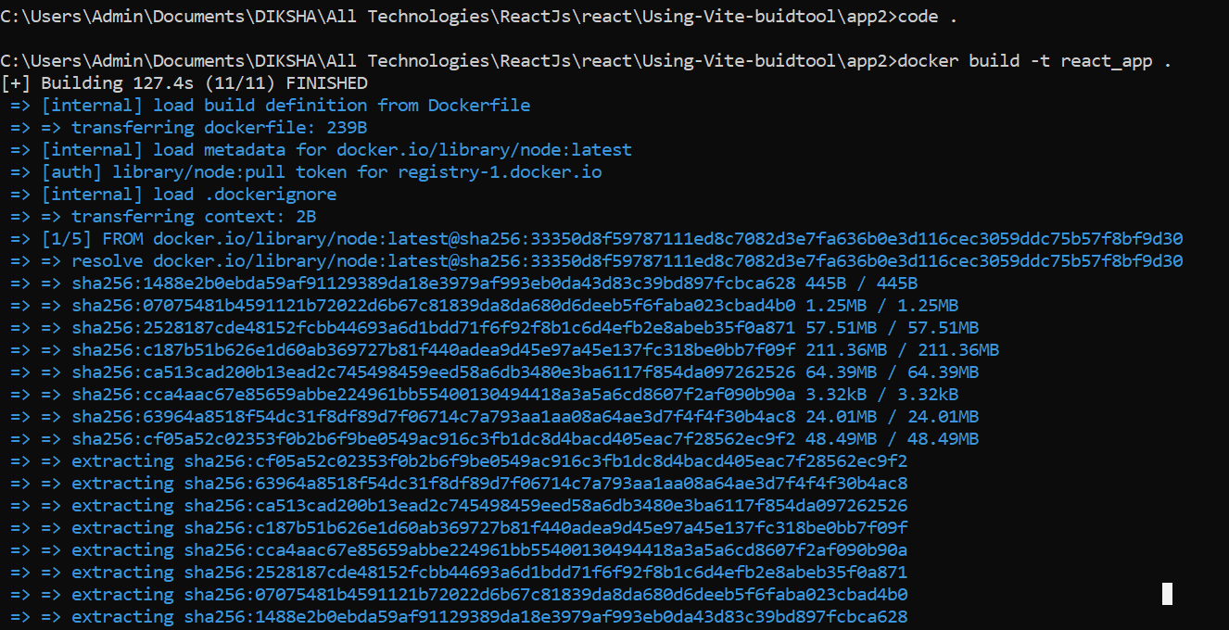
Docker_image:

Slide 13
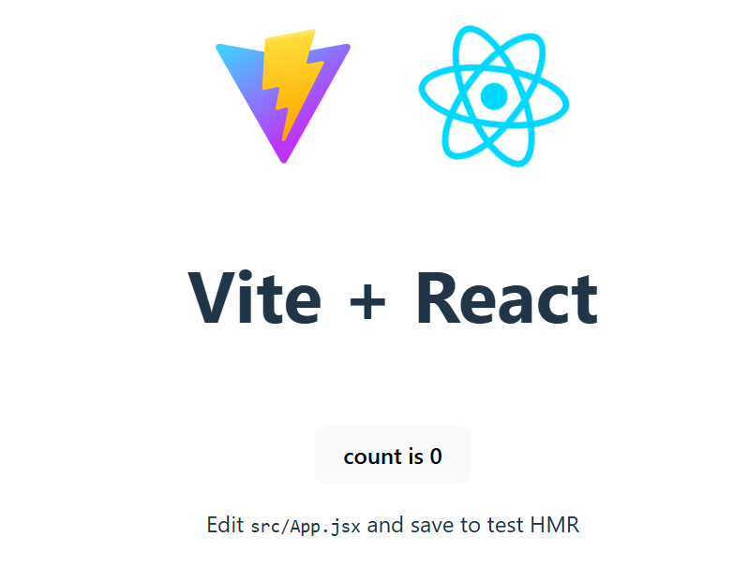
Docker container:
Output:

Slide 14
Thank You

